Slide 1



Electronic cigarettes for smoking cessation
Results from the most recent Cochrane update
Jamie Hartmann-Boyce*, Hayden McRobbie, Nicola Lindson, Chris Bullen, Rachna Begh, Annika Theodoulou, Caitlin Notley, Nancy A Rigotti, Tari Turner, Ailsa Butler, Peter Hajek
*Centre for Evidence-Based Medicine and Cochrane Tobacco Addiction Group, Nuffield Department of Primary Care Health Sciences, University of Oxford. Jamie.hartmann-boyce@phc.ox.ac.uk
Sept 2021

Slide 2
Acknowledgements and funding
The work presented today has been supported by Cancer Research UK and the National Institute for Health Research (NIHR).
Within the past 3 years, I have received funding from Cancer Research UK, the NIHR, the British Heart Foundation, Cochrane, and the University of Oxford.
The views and opinions expressed therein are those of myself (and for the paper results, my co-authors) and do not necessarily reflect those of the Systematic Reviews Programme, NIHR, National Health Service (NHS) or the Department of Health.
I have never received industry funding and have no conflicts of interest to declare.

Slide 3












Our author team

Slide 4


About Cochrane
WHAT?
Gathers and combines the best evidence from research to determine the benefits and risks of treatments/interventions
HOW?
By systematically reviewing the available evidence, with strong emphasis on quality assessment
Cochrane methods considered gold-standard
WHY?
To help healthcare providers, patients, carers, researchers, funders, policy makers, guideline developers improve their knowledge and make decisions

Slide 5

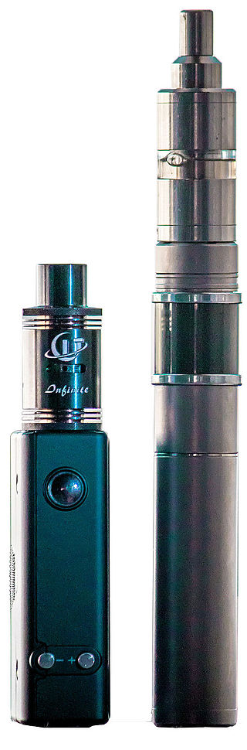

Objective of this review
Objective:
Evaluate the safety and effect of using EC to help people who smoke achieve long-term smoking abstinence
Notes:
State only talking about efficacy here

Slide 6

Living systematic review (LSR)
Search for new evidence monthly
Publish links to new evidence monthly
Update full review when new data emerges that changes, strengthens, or weakens existing conclusions, or relates to new comparisons or outcomes

Slide 7
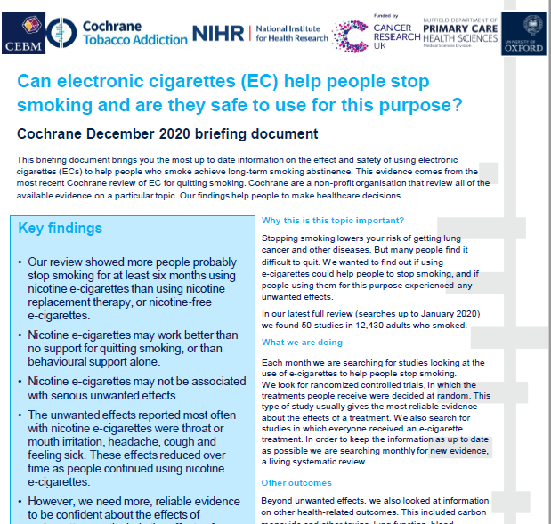

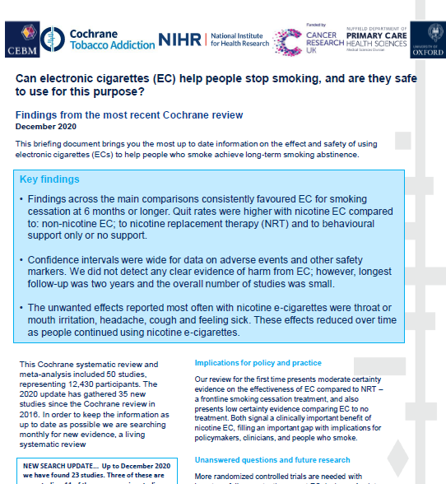
Also as part of the living systematic review project…
Review update published Sept 2021
Latest searches 1 May 2021
Five new included studies

Slide 8
Inclusion criteria
Randomized controlled trials
Longitudinal surveys
No intervention provided
Survey existing smokers, ask about EC use
Uncontrolled intervention studies
All people in the study offered EC
Smokers randomized to EC or control
Sept update:
61 studies
(34 RCTs)
16,759 participants
Measures of harm
(1 week+)
Smoking cessation (6m +)
Not included after 2016 due to nature of design and risk of confounding
Notes:
Explain relative merits and disadvantages of both types of study design. Normally we’d only include RCTs but as there aren’t many available also looked at other data. RCTs preferable as the characteristics of the people assigned the intervention and control should be similar, so we can be reasonably confident that any effect we see is due to the intervention being tested and not to something else.

Slide 9
Why might RCTs provide different answers than the observational studies?
Many different reasons, including:
variations in the effectiveness of ECs depending on the level of support provided
issues around definitions of baseline EC usage
unexplored confounders (not specific to EC – same has been found for NRT when we don’t control for confounders)
studies which analyze results in smokers based on EC use at baseline have by the nature of their design already excluded people who have successfully quit using EC, and therefore only retain participants who, at entrance to the study, would be classed as 'treatment failures' or are in the midst of a cessation attempt involving cutting down to quit.
>>Following the standard methods of the Cochrane Tobacco Addiction Group and the protocol for this review, we focus on evidence from RCTs for cessation outcomes

Slide 10

Inclusion criteria: participants
People defined as current smokers at enrolment into study, motivated or unmotivated to quit

Slide 11
Primary comparisons
Nicotine e-cigarette versus NRT
Nicotine e-cigarette versus behavioural support only/no-support
Nicotine e-cigarette versus non-nicotine e-cigarette

Slide 12
Outcomes
new outcome
Cessation*
Adverse events (AE)*
Serious adverse events (SAE)*
Changes in relevant biomarkers
6 months+
Intention to treat
Strictest definition of abstinence
Biochemically verified where available
One week or longer of EC use
One week or longer of EC use
One week or longer of EC use
Known carcinogens and toxicants
Exhaled carbon monoxide
Airway and lung function
Blood oxygen levels
Any AE where the patient outcome is death; life-threatening; hospitalization; disability; birth defect; or requires intervention to prevent any of the above
Defined as any undesirable experience associated with the use of a medical product in a patient
(as per standard Cochrane methods)
Product use
6 months or longer
Proportion of participants still using assigned study product (EC or medication) at longest follow-up
Added as part of LSR process at request from multiple policymakers
*primary outcome
Notes:
Worth noting here that quitting smoking is temporarily associated with Aes. Note that due to time constraints I won’t be covering the biomarker findings in this presentation; this topic will be discussed by others presenting

Slide 13

Searches
7 electronic databases searched to May 2021
SRNT 2021 abstracts searched
Researchers contacted
Trial registries & conference abstracts for ongoing studies

Slide 14
Numerical analyses
Pooled data where appropriate following standard Cochrane methods
Meta-analyses using fixed-effect Mantel-Haenszel model to calculate risk ratio (RR) with 95% confidence interval for each study
Risk ratio =
# of people quit in intervention group/# of people in intervention group
# of people quit in control group/# of people in control group
Risk ratio = 1 if no difference
< 1 if more people quit in control
> 1 if more people quit in intervention

Slide 15
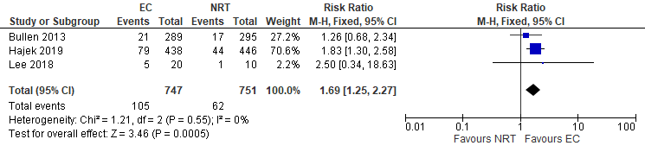
Understanding meta-analysis
Line of no effect

Slide 16
GRADE is based on 5 domains…
Risk of bias
The degree to which review authors have judged each included study to be at risk of bias
Inconsistency
Indirectness
Imprecision
Publication bias
Notes:
JHB
GRADE is a way to evaluate the certainty of the evidence – with RCTS you start at high certainty, and then work down if any of the domains flag up an issue

Slide 17
GRADE is based on 5 domains…
Risk of bias
Unexplained differences between the results of individual studies (heterogeneity). This can lead to uncertainty about the underlying effect.
Inconsistency
Indirectness
Imprecision
Publication bias
Notes:
JHB
GRADE is a way to evaluate the certainty of the evidence –

Slide 18
GRADE is based on 5 domains…
Risk of bias
Results can be downgraded because of indirectness if:
Head to head comparisons are not available
The population, intervention, comparator or outcome is different from the question the review is trying to address
Inconsistency
Indirectness
Imprecision
Publication bias
Notes:
JHB
GRADE is a way to evaluate the certainty of the evidence –

Slide 19
GRADE is based on 5 domains…
Risk of bias
Results are considered imprecise if:
The total number of events is small (usually less than 300)
The confidence intervals are wide
Inconsistency
Indirectness
Imprecision
Publication bias
Notes:
JHB
GRADE is a way to evaluate the certainty of the evidence –

Slide 20
GRADE is based on 5 domains…
Risk of bias
A systematic under or overestimate of an effect due to selective publication of studies. This can happen when the results of a study are not reported. If, for example, studies that detect an effect are more likely to be published than those with negative results, the meta-analysis will be biased towards positive results. You can look at this with a funnel plot if there are 10 or more studies
Inconsistency
Indirectness
Imprecision
Publication bias
Notes:
JHB
GRADE is a way to evaluate the certainty of the evidence –
What do you think the certainty of evidence was for their review?

Slide 21
Any questions so far?

Slide 22
September update
61 included studies (5 new; 34 RCTs)
>16,000 participants
7 (all contributing to our main comparisons) at low risk of bias overall, 42 at high risk overall (including all non-randomized studies), and the remainder at unclear risk.

Slide 23
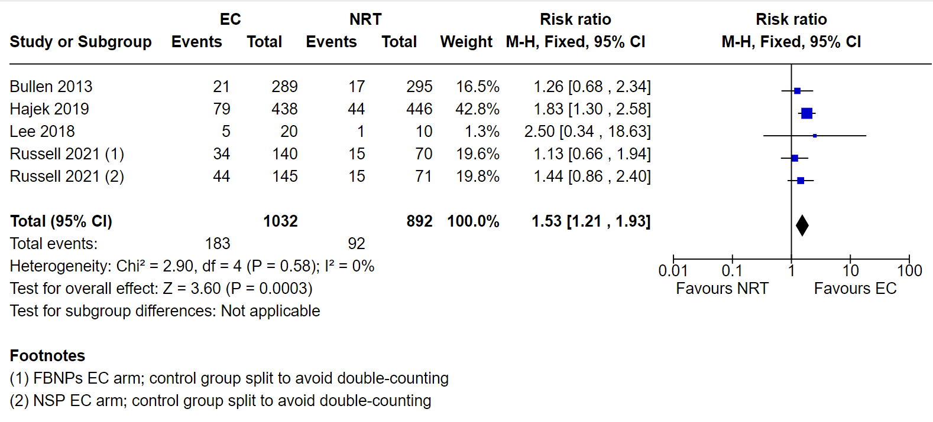
Nicotine e-cigarette versus NRT: Quitting at 6+ months
GRADE certainty of evidence: MODERATE (downgraded one level due to imprecision)

Slide 24
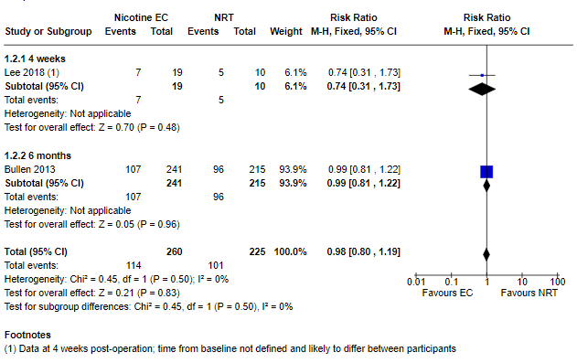
Nicotine e-cigarette versus NRT: Adverse events at 1+weeks
GRADE certainty of evidence: MODERATE (downgraded one level due to imprecision)

Slide 25
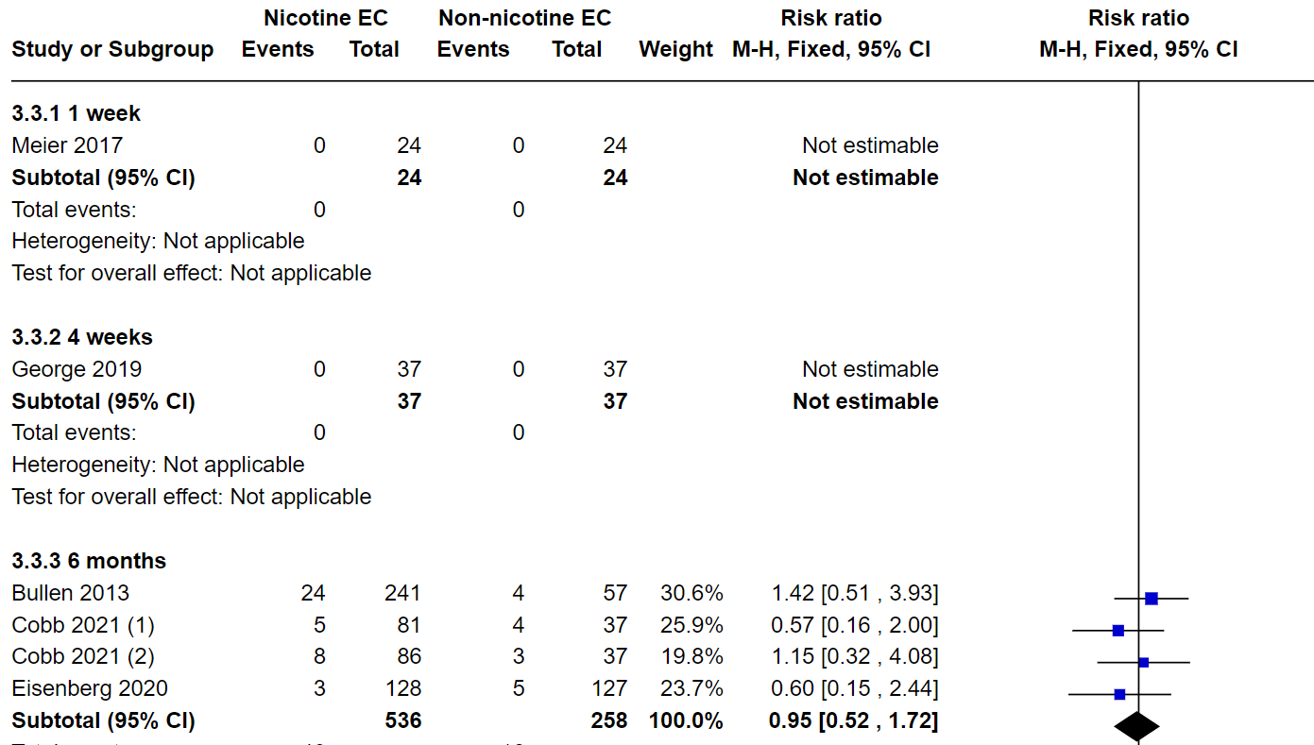
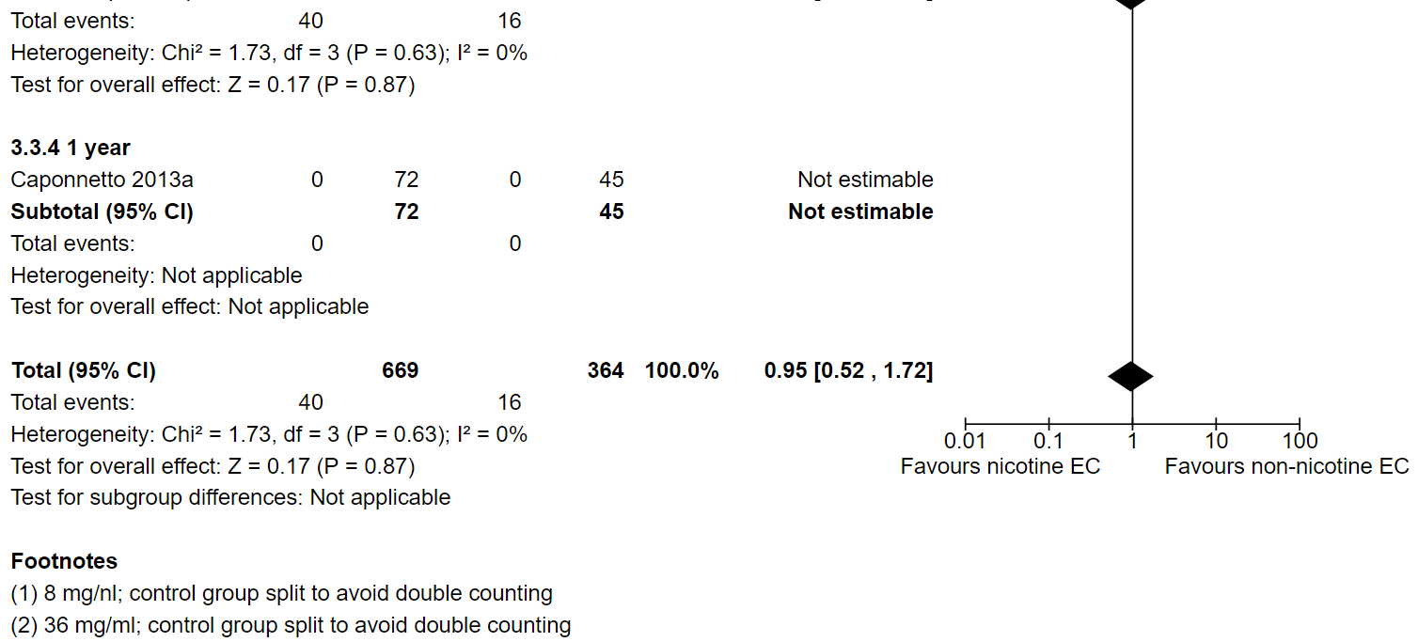
Nicotine e-cigarette versus NRT: Serious adverse events at 1+weeks
GRADE certainty of evidence: LOW (downgraded two levels due to imprecision)

Slide 26
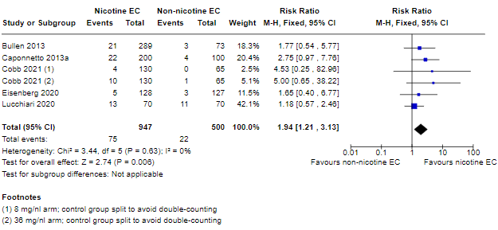
Nicotine e-cigarette versus non-nicotine e-cigarette: Quitting at 6+ months
GRADE certainty of evidence: MODERATE (downgraded one level due to imprecision)

Slide 27
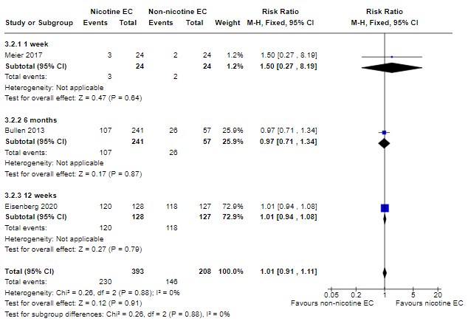
Nicotine e-cigarette versus non-nicotine e-cigarette: Adverse events at 1+ weeks
GRADE certainty of evidence: LOW (downgraded two levels due to imprecision)

Slide 28
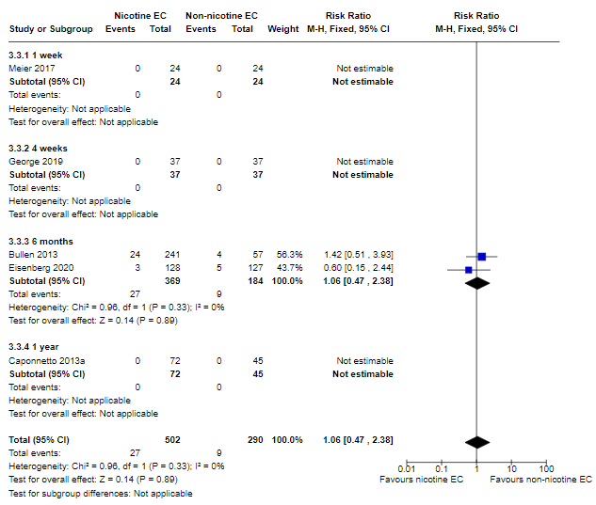
Nicotine e-cigarette versus non-nicotine e-cigarette: Serious adverse events at 1+weeks
GRADE certainty of evidence: LOW (downgraded two levels due to imprecision)

Slide 29
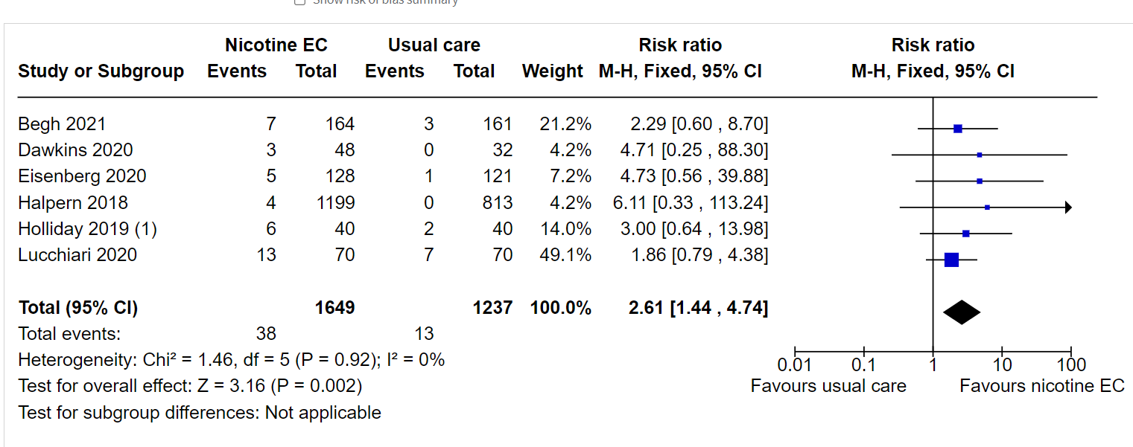
Nicotine e-cigarette versus behavioural support only/no support: Quitting at 6+ months
GRADE certainty of evidence: VERY LOW (downgraded two levels due to risk of bias; one level due to imprecision)

Slide 30
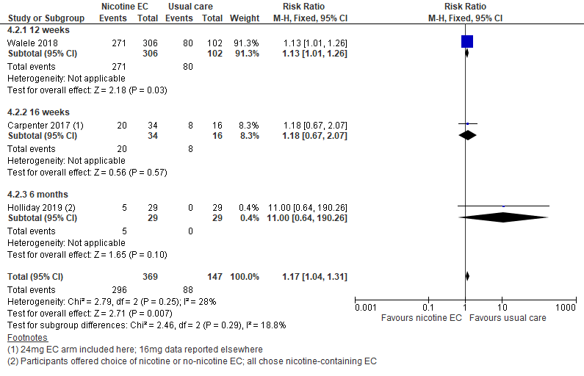
Nicotine e-cigarette versus behavioural support only/no support: Adverse events at 1+weeks
GRADE certainty of evidence: VERY LOW (downgraded due to risk of bias and imprecision)

Slide 31
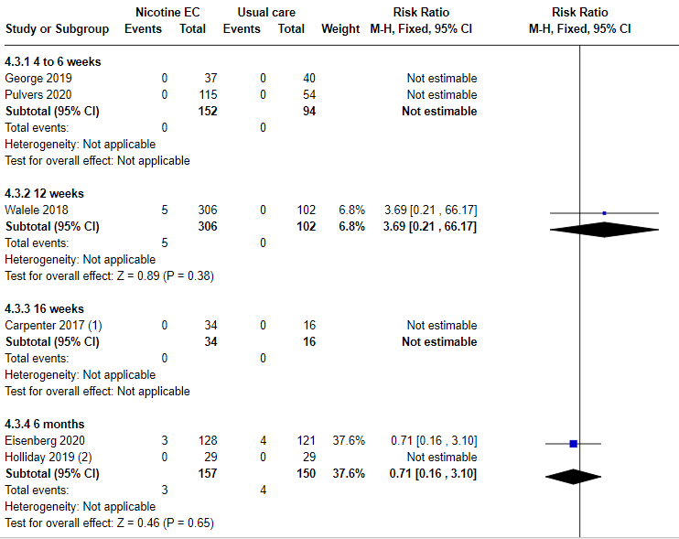
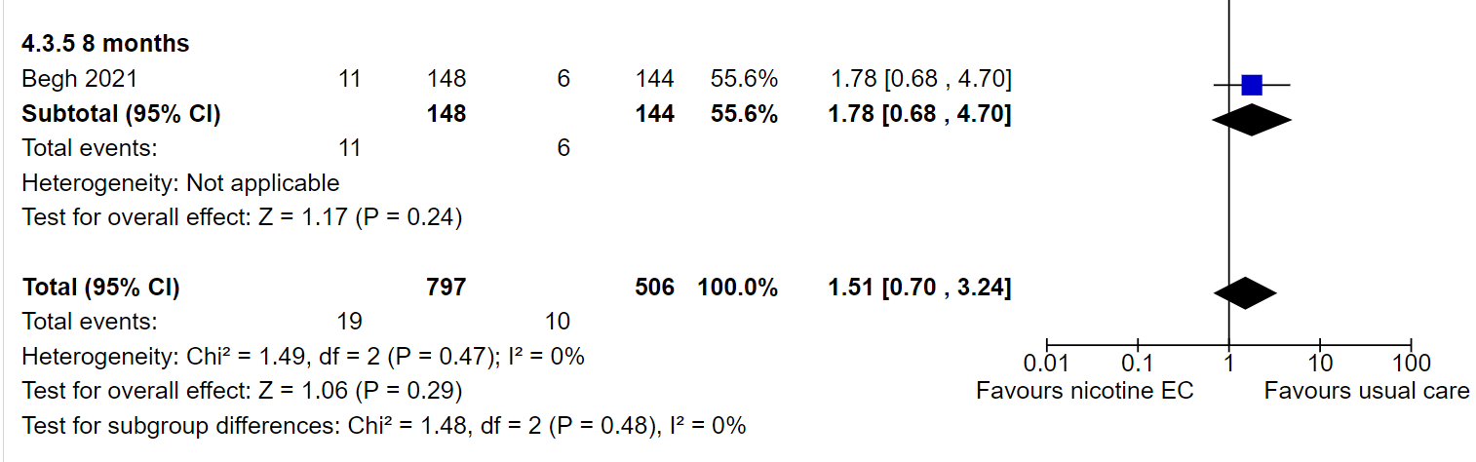
Nicotine e-cigarette versus behavioural support only/no support: Serious adverse events at 1+wks
GRADE certainty of evidence: VERY LOW (downgraded due to risk of bias and imprecision)

Slide 32
Implications for practice
Evidence suggesting nicotine EC can aid in smoking cessation is consistent across several comparisons. There was moderate certainty evidence, limited by imprecision, that EC with nicotine increased quit rates at six months or longer compared to non-nicotine EC and compared to NRT. There was very low certainty evidence that EC with nicotine increased quit rates compared to behavioural support only or no support.
The effect of nicotine EC when added to NRT was unclear.
None of the included studies (short- to mid-term, up to two years) detected serious adverse events considered possibly related to EC use.
The most commonly reported adverse effects were throat/mouth irritation, headache, cough, and nausea, which tended to dissipate over time. In some studies, reductions in biomarkers were observed in people who smoked who switched to vaping consistent with reductions seen in smoking cessation.
Notes:
Crucially unchanged from previous version – new studies have not changed

Slide 33
Implications for research
Further trials should:
Measure cessation at six months or longer.
Use active comparators
Assess safety profile for as long as possible
Be powered to detect differences in safety outcomes
Present safety in both absolute and relative risk terms (in comparison to the risks of continuing to smoke tobacco).
Offer recent devices to participants, to be most representative of what will be on the market at the time results are released. Data on pod type EC are particularly lacking. Protocols and statistical analysis plans should be registered in advance and openly available.
Provide EC in a way that would be used in real-world settings.
Further reviews, using best available methods, need to be conducted to evaluate the possible relationships between EC use and availability and youth uptake of EC and conventional cigarettes.

Slide 34
A quick note on further reviews…
Objective: to assess relationship between use and availability of e-cigarettes and tobacco smoking in young people
Include: longitudinal cohorts, population data (via multiple time series, instrumental variable studies)
Outcomes: population rate of tobacco use in young people; cessation, uptake, and progression of tobacco use in young people
Synthesis (?): Causal chains developed a priori, interrogated with temporal qualitative comparative analysis and framework synthesis

Slide 35
See full review for
More detail on everything that’s been presented
Secondary outcomes
Other comparisons
Data from uncontrolled studies
Comparison with other reviews
Updates to and information on the living systematic review: https://www.cebm.ox.ac.uk/research/electronic-cigarettes-for-smoking-cessation-cochrane-living-systematic-review-1

